Slide 1
Pushing the Edge – Monetization Coming into Focus
Jeff Johnston, Lead Economist
June 28, 2022

Slide 2
Overview
Forces and Applications Driving Adoption
Market Opportunities
Edge Computing Overview
Pushing the Edge – Monetization Coming into Focus

Slide 3
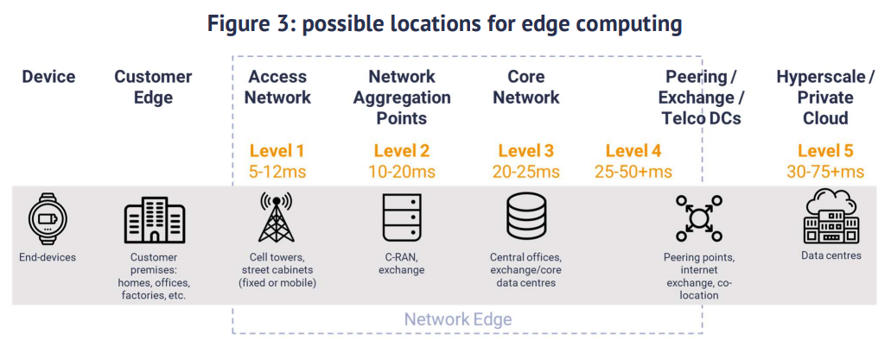
What is Edge Computing
Edge computing is a distributed information technology (IT) architecture in
which client data is processed at the periphery of the network, as close to the
originating source as possible

Slide 4
Edge Computing Growth – Datacenter types
Far edge computing growth represents opportunities for operators in smaller, tier two/three markets

Slide 5
Overview
Forces and Applications Driving Adoption
Market Opportunities
Edge Computing Overview
Pushing the Edge – Monetization Coming into Focus

Slide 6
Forces Driving Edge Computing
Latency
COVID-19 accelerated the trend in decentralized data storage and computation
In 2018 10% of enterprise data was being created and processed outside a central datacenter/cloud, in 2025 that number is projected to be 75%.
AR/VR, AI automation applications, autonomous vehicles
Cost
In some cases it’s cheaper to store and process large amounts of data on premise or near premise versus transporting it to the cloud
New technologies in network virtualization are reducing capex and opex

Slide 7
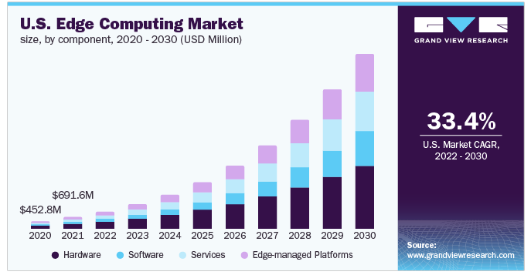
Edge Computing Growth

Slide 8
Use Cases Galore
Precision
Ag
Streaming
Video
Self Driving
Vehicles
Smart
Homes
Cloud
Gaming
Smart Grid /
Cities
AI / Machine
Learning
AR / VR
Traffic
Management
Content
Delivery
Network
Virtualization
Private
LTE / 5G
Automated
Factories

Slide 9
C-RAN
Centralized/Cloud Radio Access Network (C-RAN)
Cloud computing-based architecture for RAN that enables large-scale, collaborative radio access network support and virtualization capabilities
Baseband units are relocated from the tower to an edge datacenter location (BBU hotel)
Fiber connects the BBU hotel to the remote radio heads
Increase network efficiency with simplified scale and flexibility. Enables self-optimizing network technology
Decoupling vendor hardware and software makes capex more efficient. Lower opex from reduced heating, cooling and power requirements

Slide 10
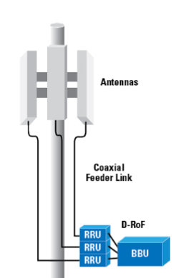
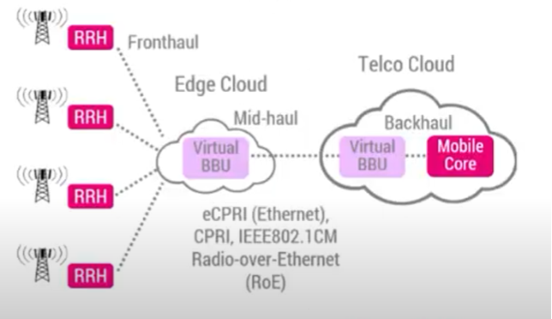
Traditional vs C-RAN
Traditional Macrocell
Network Architecture
Virtualized / C-RAN Architecture

Slide 11
Wireless Operator Activity
Dish Network’s wireless network architecture is largely centered around C-RAN/O-RAN
According to Dish, it’s enabling them to build a nationwide network much cheaper than the incumbents
Dish Network will establish the C-RAN ecosystem of vendors and technologies
Verizon’s partnership with Amazon Web Services (AWS) Wavelength
AT&T partnership with Microsoft Azure

Slide 12
Private Wireless (LTE/5G) Network
Private LTE is a network that is run specifically for the benefit of an organization,
such as a factory, farm or police department. Only authorized users of that organization
have access to the network.
Includes; radio hardware, mobile core, devices
Utilizes standards-based equipment (carrier grade)
Precision agriculture is an ideal application
Customized to meet the needs of users
Data stored and processed on premise or at third party (edge) datacenter

Slide 13
Why Now?
Citizens Broadband Radio Service (CBRS) spectrum auction rules enabled smaller organizations to acquire licensed spectrum
Unlicensed portion of band reduced costs to build private networks
1,200MHz of unlicensed spectrum being made available in the 6GHz band
Broad ecosystem of equipment manufacturers, system integrators, wireless operators, consultants, etc. is developing
Carrier grade network can deliver speeds over 200Mbps
Virtualization and network core as-a-service have simplified deployments

Slide 14
Growth Projections

Slide 15
Private Networks on the Farm
According to FCC Commissioner Brendan Carr, just one plant in a field can provide 18 GB of data, which means the average corn field has about 28 times the amount of data as the Library of Congress!
Precision Spraying: Variable-rate applications of fertilizer and pesticides by traditional field sprayers
Field Monitoring: Crop surveillance, plant health diagnostics
Precision Planting / Harvest: Machine learning applications for robots that can identify and measure the ripeness of fruit
Precision Livestock Monitoring: Diagnostic tools that detect early disease in cattle, hogs and chickens

Slide 16
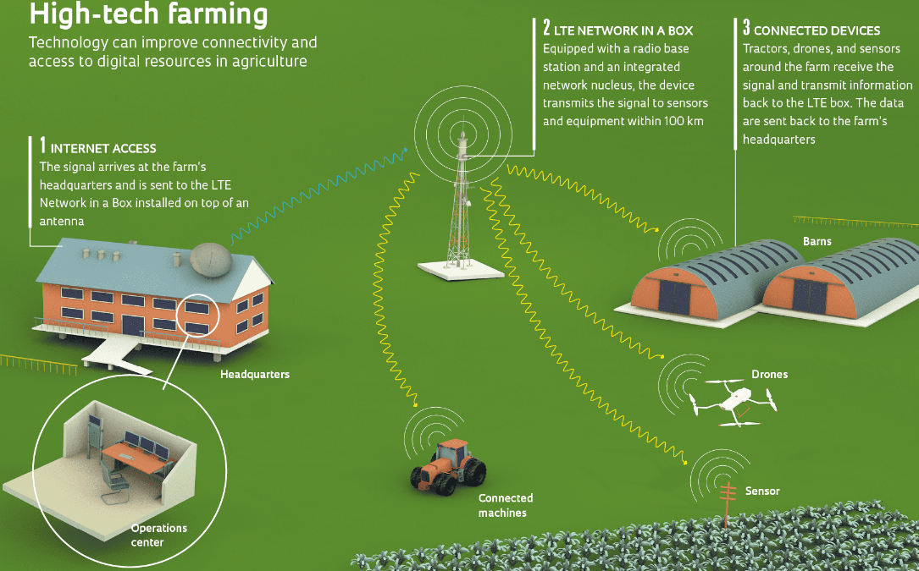
Farm Illustration

Slide 17
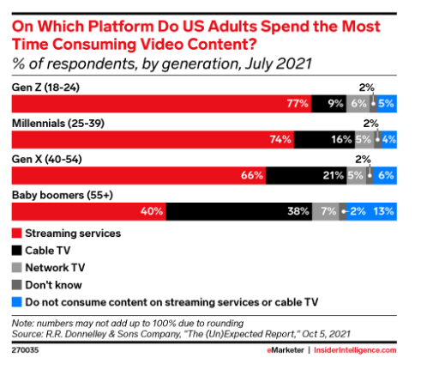
Content Delivery Networks (CDN)
Streaming is the new black…

Slide 18
Augmented Reality / Virtual Reality
Fully immersive AR and VR experiences with 6 degrees of freedom will require
connection speeds between 200 to 5,000 Mbps
Source: ABI Research

Slide 19
Autonomous Driving Data Impact
According to the Automotive Edge Computing Consortium (AECC), self-driving EVs may eventually need to offload as much as 5,000GBs per hour of operation

Slide 20
Overview
Forces and Applications Driving Adoption
Market Opportunities
Edge Computing Overview
Pushing the Edge – Monetization Coming into Focus

Slide 21
Edge Computing Opportunity
Telecom operators are exposed to over 20% of the edge computing market via connectivity, managed services, hosting, etc.
Other:
Hardware,
Integration,
Managed Services
21%
Connectivity
9%
Applications
70%
Source: STL Partners

Slide 22
Potential Opportunities
Opportunities in edge computing should be evaluated on a case-by-case basis.
“Build it and they will come” may not be the right approach.
Partnerships and creativity as hyperscalers move to the edge
Verizon/AWS and AT&T/Microsoft Azure
AWS partnership with micro data center provider Vapor IO along with Crown Castle
Private wireless LTE/5G (build networks, network operations support)
Shared infrastructure – co-location at the edge
Support C-RAN initiatives with connectivity and edge datacenters

Slide 23
THANK YOU!

